Slide 1

DriverPass System Analysis
Clifton Brann
Notes:
[No speaker notes required for this slide.]

Slide 2

System Requirements
The system will validate each user, though the use of a user name and password.
The system will monitor user access and log changes to data, to maintain accountability.
The system will be cloud based.
The system should function and display comparably on desktop and mobile devices.
Notes:
The two functional requirements I would like to address are the system validation of each user and system monitoring and logging to track accountability. It is important for the system to validate each user that logs in for security purposes, lesson tracking, and on the road training hours. Each authorized user will have a unique login or user name and a secure password, which will be authenticated each time they access the system. Based on the level of access and their stats as a student or an employees the users will have access to different parts of the system. Utilizing a user name and password authentication system is a good way to protect against unauthorized users gaining access to to sensitive information, like credit card numbers. By enabling the system to track users activities, the system can track grades on online tests, changes to on the road appointments, or changes to demographic information, just to name a few, and allows for accountability when problems arise. It is important to know which user made what changes to what data and when, in case there are billing issues or any other issues, responsibility can be easily assigned to the particular user.
The two non-functional requirements are: the system should be cloud based and the system should function and display comparably on both desktop and mobile devices. By utilizing a cloud based approach to the system, it frees the company up from having to build, maintain, and update all the hardware required to store the data and transmit it across the internet. A cloud based approach will also allow for easier integrations of different modules, such as a credit card processing module or a security module. It will also increase overall reliability of the system, since the data will be held in remotely and backed up in other locations, by reducing the chances of a single point of failure, like an outage caused by a natural disaster such as a tornado or hurricane. And because the system will be accessed by both desktop and mobile devices, it should both display and function very similarly on these devices. While it can be frustrating to scroll across large documents on the small screen of a smartphone, the functionality and responses should be very similar when the different actions are requested by pressing buttons or navigating the system. It is important to note that although different devices have different operating systems and capabilities, the core functions of the system should be the same in all circumstances.

Slide 3
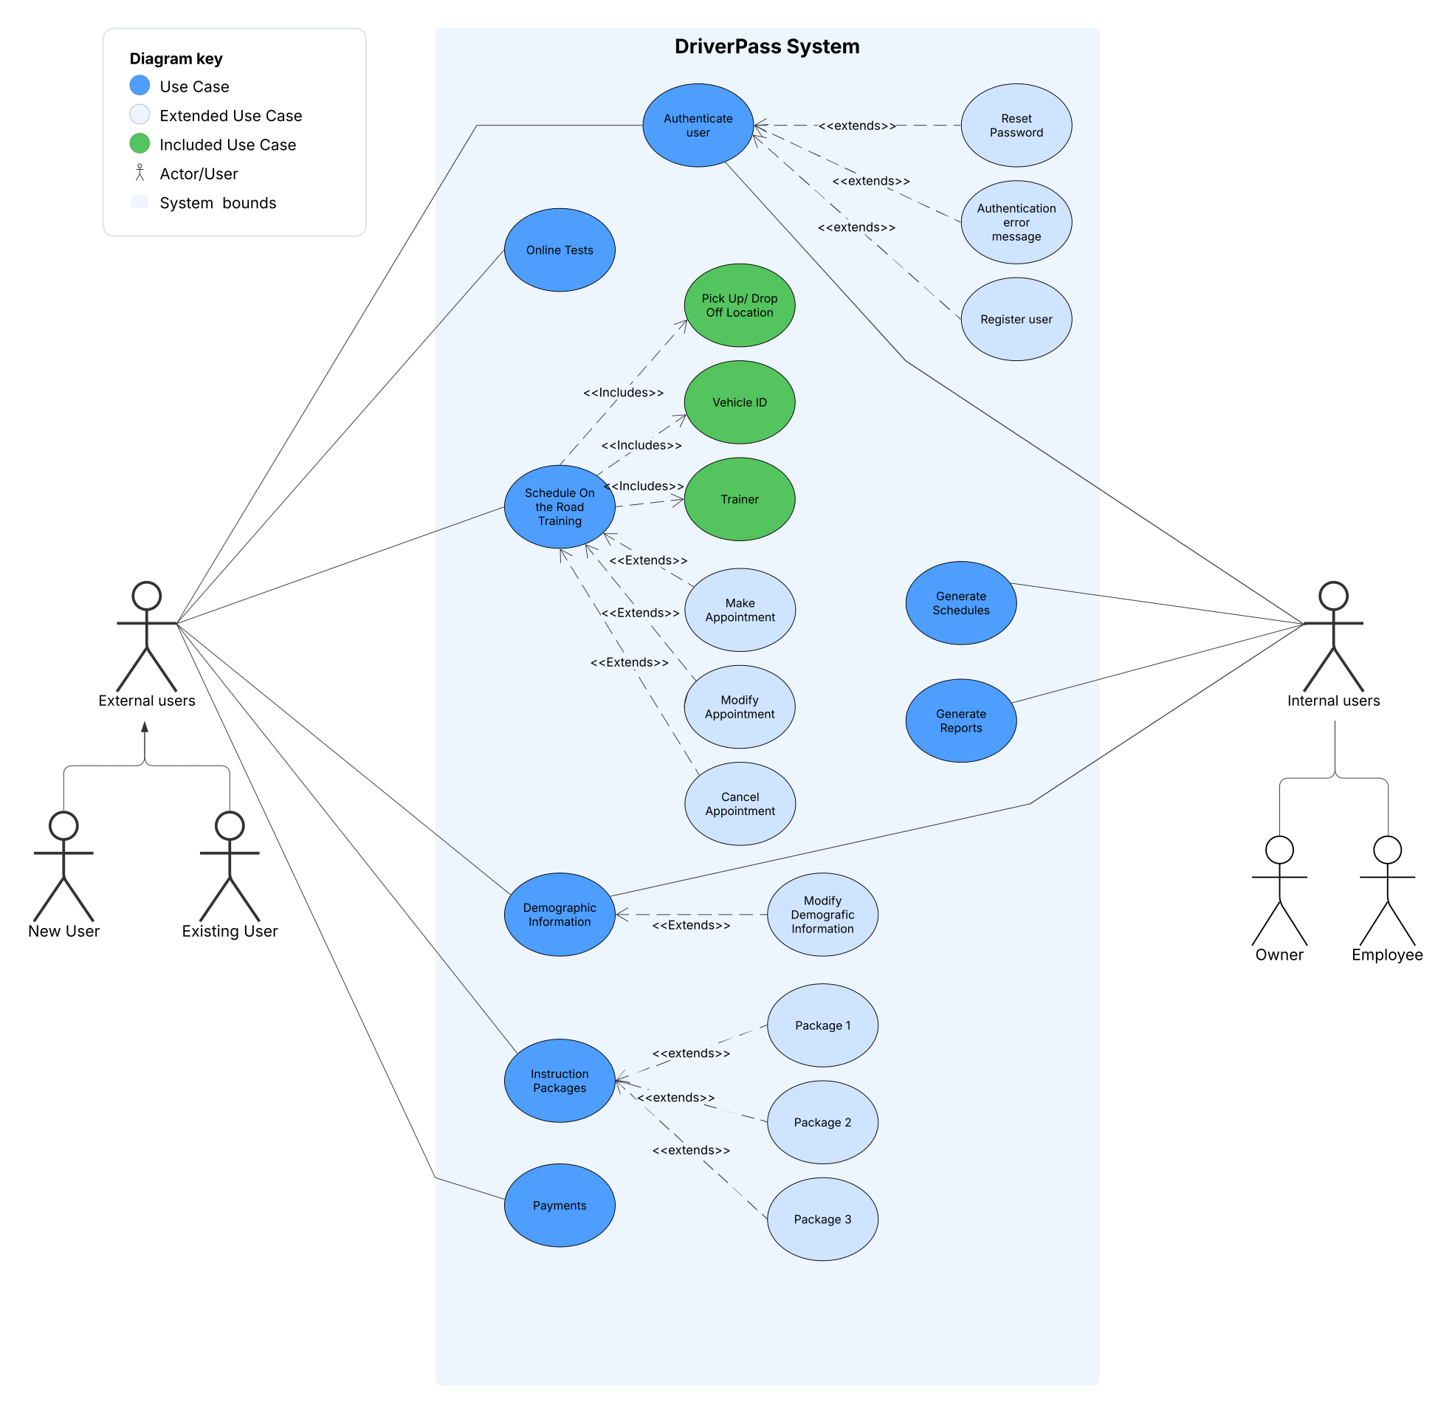
Use Case Diagram
Notes:
This is called a Use-Case diagram, and it shows the major activities or functions of the system. Simply put this diagram shows an overview of the different functions or activities of the system. The different ovals show the different ways the users can interact with the system, and different things that can happen within the system. The light blue box represents the system, and outside the box, represented by stick figures are the users.
On the left side of the diagram are the ‘external users’ which will be either new or existing students in the program. On the right side are the ‘internal users’, company employees, which will range from the Owner, CTO, Driver Trainers, Secretary, and other employees of the company.
Starting at the top of the diagram, you see that all the users will login to the system with their own user name and password, which will be authenticated by the system. The system will allow users to register as a new user, reset their password if they have forgotten it, or receive an error message if they have entered an incorrect user name or password.
After an existing user has logged in, depending on what kind of user they are, they will be routed to their particular landing page where they can access the different functions of the system, as allowed by their status.
New students or employees would be required to register with the system, and provide a username and password. After a new student or employee has had their user name and password verified, they would enter the required information, such as demographics, banking or payment information, and upload a photo of themselves.
The new students would then be prompted to choose one of the three instruction packages on offer, and be prompted to pay for the package through the secure payment portal. Once the payment was processed, the student would then be able to access the resources covered by the package they chose. Students would be able to make, change, or cancel appointments for on the road training in the system. When scheduling on the road appointments, the student would enter the following data: date, pickup time, pickup location, drop-off location, driver trainer, and vehicle.
Company employees like the Driver Trainers would use the system to generate schedules based on the appointments set up by students. The system would generate individual pages for each on the road session complete with all pertinent information, like date, time, pickup and drop off locations, including pictures of both the trainer and student for positive identification. The training page would also have any special needs or accommodations for the specific student listed, so the Trainer was aware and informed, and could modify the lesson as needed. The training sheet also has a driver notes area for the Trainer to document progress, areas of concern, and any other pertinent information.
The system would also be able to generate other reports needed for company operations such as: accounting, employee hours, payroll, student progress, vehicle status, and revenue.

Slide 4
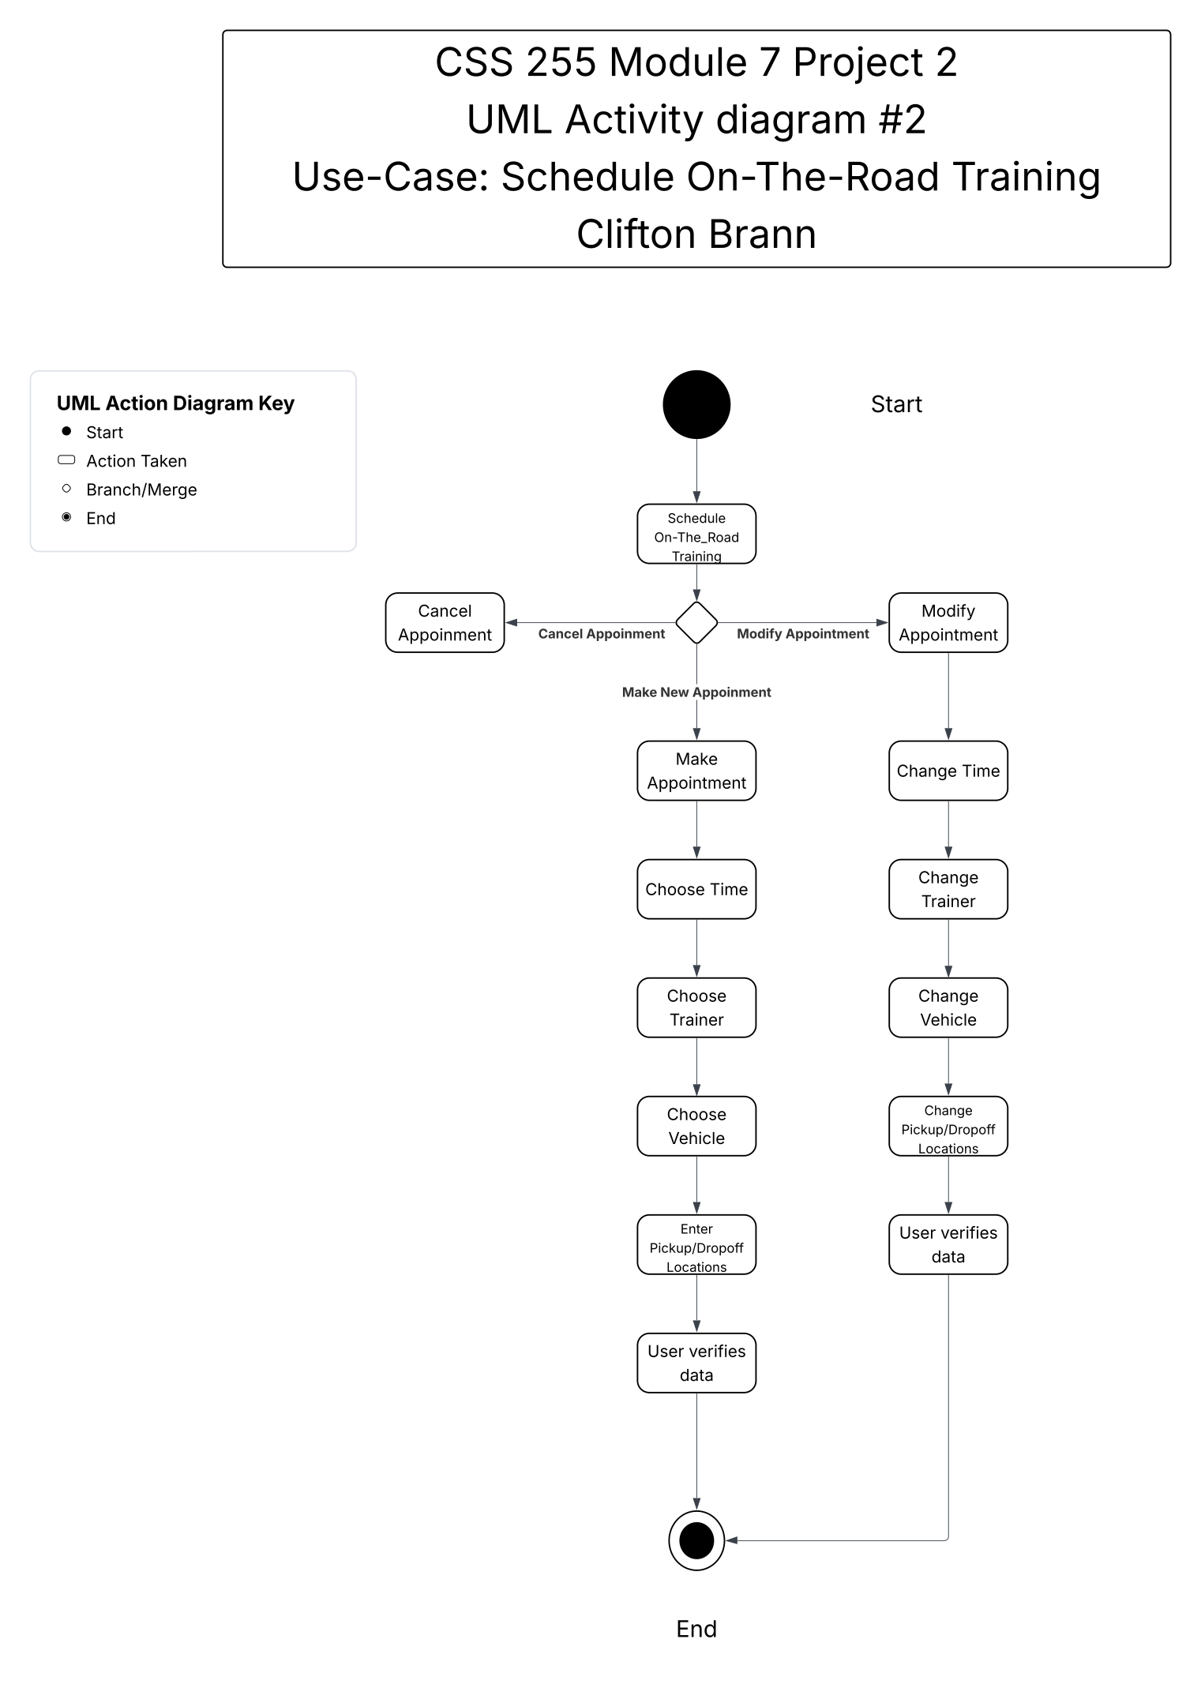
Activity Diagram
Notes:
[Explain your diagram. Which use case are you breaking down? What are the steps for this use case? How did you account for DriverPass’s needs in your design? In your explanation, keep your audience in mind. Avoid the use of technical terms such as “nodes,” “control flows,” and so on.]
This diagram shows the steps and options in the Schedule On-The-Road Instruction Appointment tree. At the top of the diagram is the staring point, it is assumed that the student has logged into the system, and been verified, and has chosen a particular package and is going to schedule an On-The-Road appointment.
The first step brings the student to the Scheduling landing page, which will offer three choices: make a new appointment, modify an existing appointment, and cancel an existing appointment.
If the student chooses to make a new appointment, the student will follow the center branch and enter the required information as prompted, verify the data is correct, and then the the data will be saved for later use in generating schedules and appropriate paperwork.
If the student chooses to modify an existing appointment, they will be prompted to change any data, verify the chances for correctness, and again the data will be saved for schedule reports later.
And finally if the student choose to cancel an appointment, they will indicate what appointment needs be cancelled, and a reason why they are cancelling it.
After each branch is completed ,the student will be routed back to their landing page.
While planning the system design, it became clear that there needed to be to be a process to make, modify , or cancel appointments, whether it is students or employees making the arrangements or changes.

Slide 5
Security
In an effort to maintain system security, the use of individual unique combinations of user names and password will be used to access the system.
Access to different parts of the system will be monitored and maintained by the IT department.
The security package will be provided by the Cloud-Based provider.
The security package will have built in attack detecting abilities.
Notes:
As a first line of defense the system will utilize a user name and password for validation and authentication for all users. Every user will have their rights and accesses assigned, according to the system access rules. The system access rules and rights will be written, built, and maintained by the IT department at the company.
The external or student users will have access to specific parts of the system like the login system, payment system, online education, and appointment scheduling system. Students would be able to change some of their own data; for example a student would be able to change a payment card number or update their address. But a student would not be able to change their online test scores, number of attempts at a specific test, or access history, because those data are outside of their permissions in the system.
The internal users or company employees would also have varied levels of access depending on their job requirements. The owner of the company, the head of IT and CTO would have the most access to the system and be able to change or access whatever they needed to. Whereas Trainer would have access modify to their own demographic information, but would not be able to change clock in or clock out times.
The different levels and rules of access would be created, maintained and enforced by the IT department or head of IT. By establishing clear access rules for the different types of system users, the chance of disastrous mistakes goes down. If a student can’t access the accounting and payroll parts of the system, then there are a lot fewer worries to be had. It is important to have access to limited as much as is possible, to improve security, but it can’t be so restricted as to cripple students or employees from being able to effectively utilize the system.
I am reminded of the story of people using a system in an way that caused unexpected results, both in system behavior and legal consequences. When the users were asked why they were doing the certain activity, the response was, “Well, the system let us do it, and no one said not to…”
The Cloud-Based server and database provider will also be providing the security package, so it will be constantly and consistently updated to respond to the most recent threats. Another reason for using an off the shelf solution is that it will simplify and shorten the timeframe for building and deploying the system. Since there are already many effective and availably security packages available, it doesn’t make sense to build a new one from scratch. And since the security package will be provided by the Cloud vender, it will have some built in abilities to detect and neutralize some attacks, like brute-force login attacks and other common cyber attacks.

Slide 6
System Limitations
Internet access will be required to access the system.
Cellular or mobile network coverage may not be accessible everywhere.
As the needs of the company changes, changes to the system will require the services of a software engineering team.
Notes:
[What are the limitations of your design? In your explanation, keep your audience in mind by avoiding the use of technical terms.]
Since the system owners have chosen to utilize a Cloud-Based approach to data hosting, Internet access will be necessary to access the system. If the Internet access goes down, then the system will be inaccessible to users. The owner has requested offline data access, and while downloaded data or reports would be readable, but not editable to avoid data redundancy in the databases.
And since the system is Cloud-Based, users who depend on mobile or cellular data will depend on the strength and coverage of the network. Which means that if there is no mobile network access, the the system will be inaccessible to the users.
The scope of the project is limited to building what is currently needed, any future changes will need to be designed and implemented by a software engineering team. Although the company will be able to enable or disable the different package to control class size and enrollment, but adding or editing any of the options in the packages will take more resources than can be provided by the maintenance team.

